Slide 1
Presenting Prediction Of Diabetes Using Random Forest

Slide 2
WHAT IS RANDOM FOREST
Random forest is a popular machine learning algorithm that belongs to the supervised learning technique. It is based on the concept of ensemble learning, which is a process of combining multiple classifiers to solve the complex problem & improve the performance of the model.
There are two major parts in Random Forest :-
Bagging.
Boosting.

Slide 3
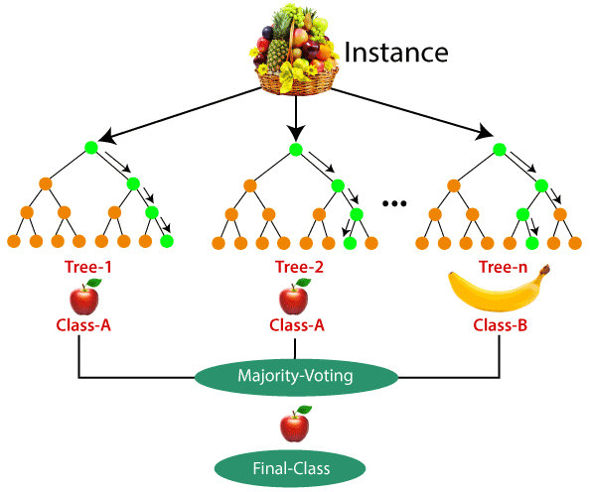
ALGORITHM
Step 1:- Select random K data point from the training set.
Step 2:- Build the decision trees associated with the selected data point.(Subset)
Step 3:- Choose the number of N for decision trees that you want to build.
Step 4:- Repeat Step 1 & 2.
Step 5:- For the new data point, find the predictions of each decision tree, and assign the new data points to the category that wins the majority votes
Example:-

Slide 4
APPLICATIONS
There are mainly four sectors where Random forest mostly used :-
Banking.
Medicine.
Land Use.
Marketing.
It is also can be used in Share market & Farm.

Slide 5
PROS
Random Forest is capable for performing both classification and regression tasks.
It is capable for large data sets with high dimensionality.
It enhances the accuracy of the model and prevent the overfitting issue.
CONS
Although Random forest can be used for both classification and regression tasks, It is not more suitable for Regression tasks.

Slide 6
Thank you

